Slide 1
Introduction
Corona is a deadly disease that started spreading throughout the world starting in December 2019. It was first diagnosed in Wuhan, China.
Since then, it has spread worldwide and has effected 2,475,440 people and 170,069 people have died due to this infection.
Scientists have since then dedicated their time in the research of this disease and here we attempt to take a deeper look into this problem.

Slide 2
Dataset
As this is quite recent phenomenon to get a live data was more suitable to our project.
The data was extracted from the website of WorldOMeter which provides live data for cases all over the world for Coronavirus.
This was achieved by running Python web-scraping code.

Slide 3
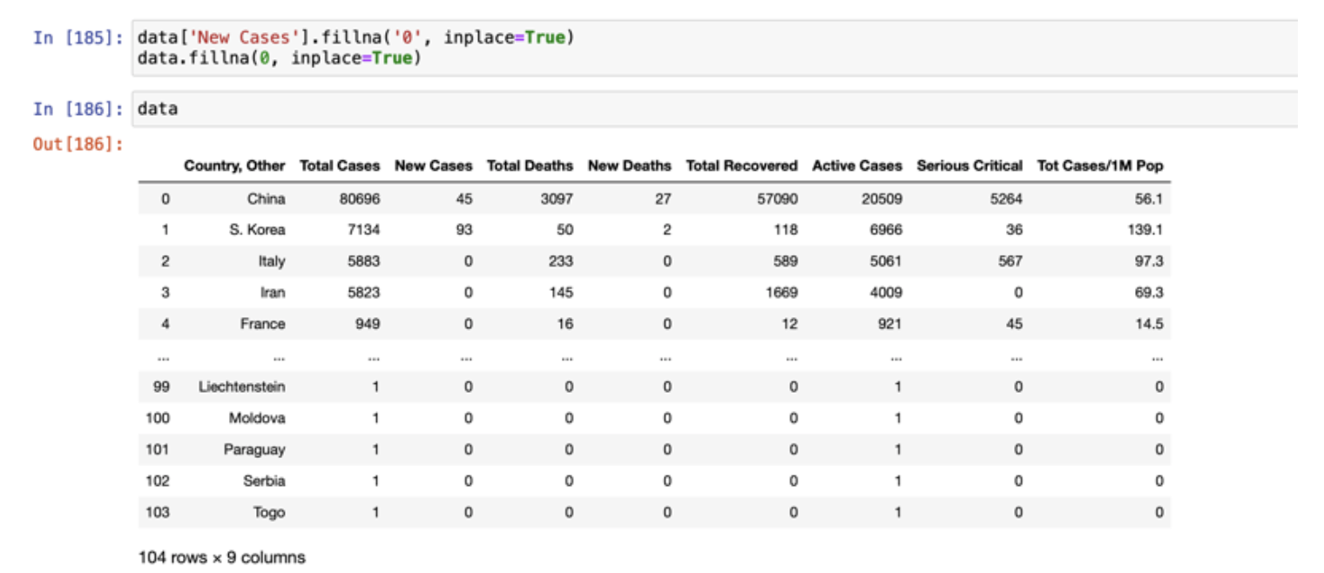
Data Preprocessing
As this data was updated daily there was not much of preprocessing required as there were no redundancy or missing values.
Once loaded on the system the data looked like this

Slide 4
Data Visualization
An important part to understand the flow of the project is to visualize the data.
Our data has been visualized in 2 parts one on March 13 and the other on April 4
For all the visualization the data was taken using Python and visualized using Tableau.

Slide 5
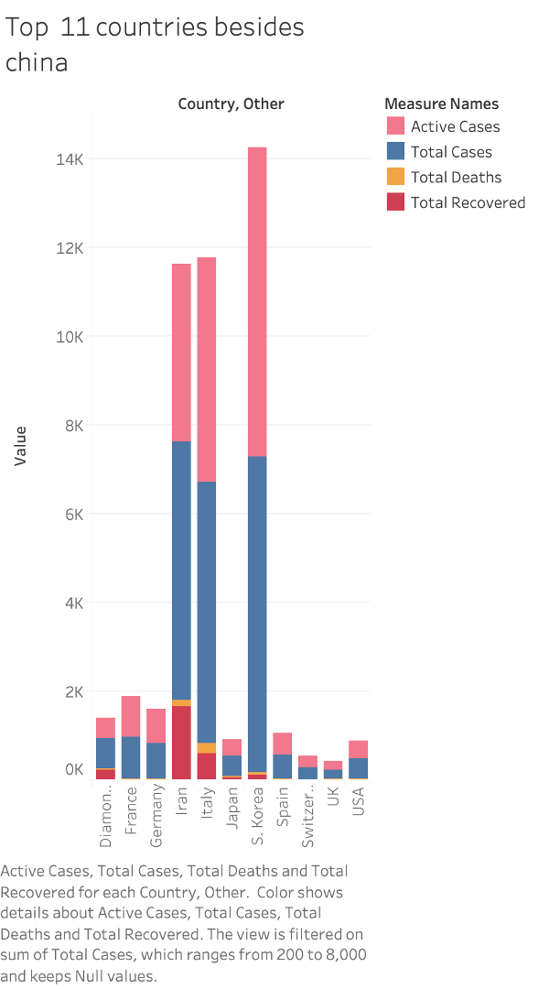
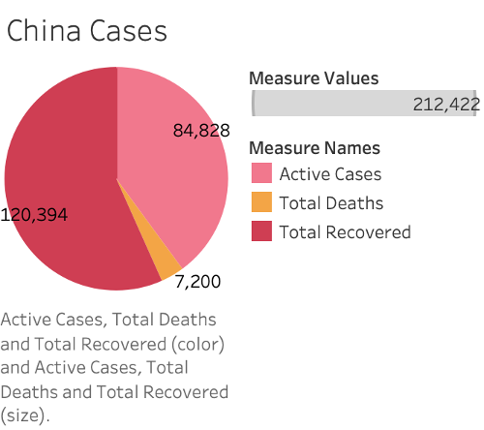
Data for 3/13

Slide 6
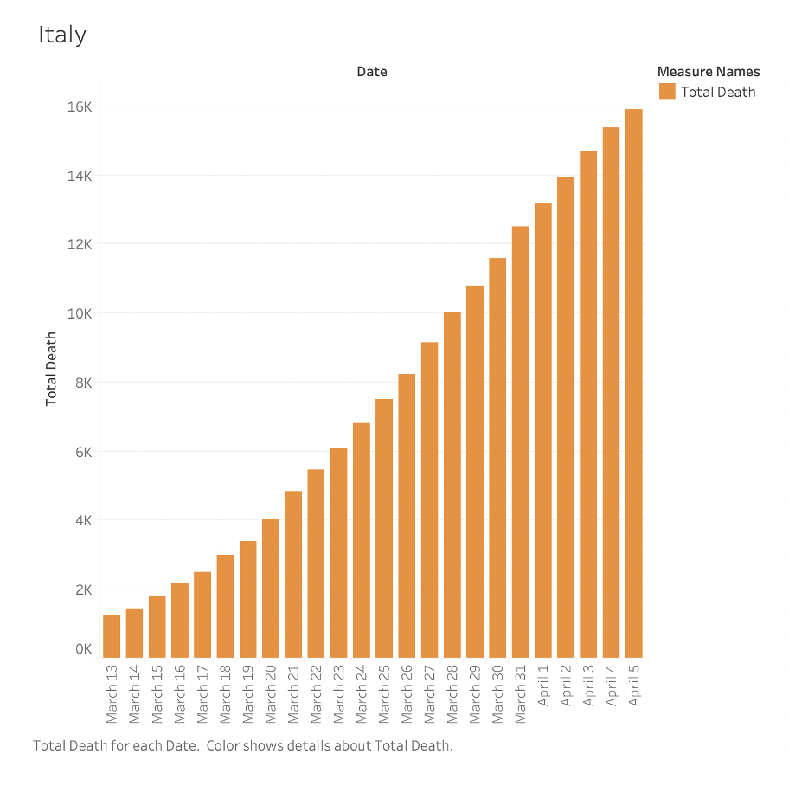
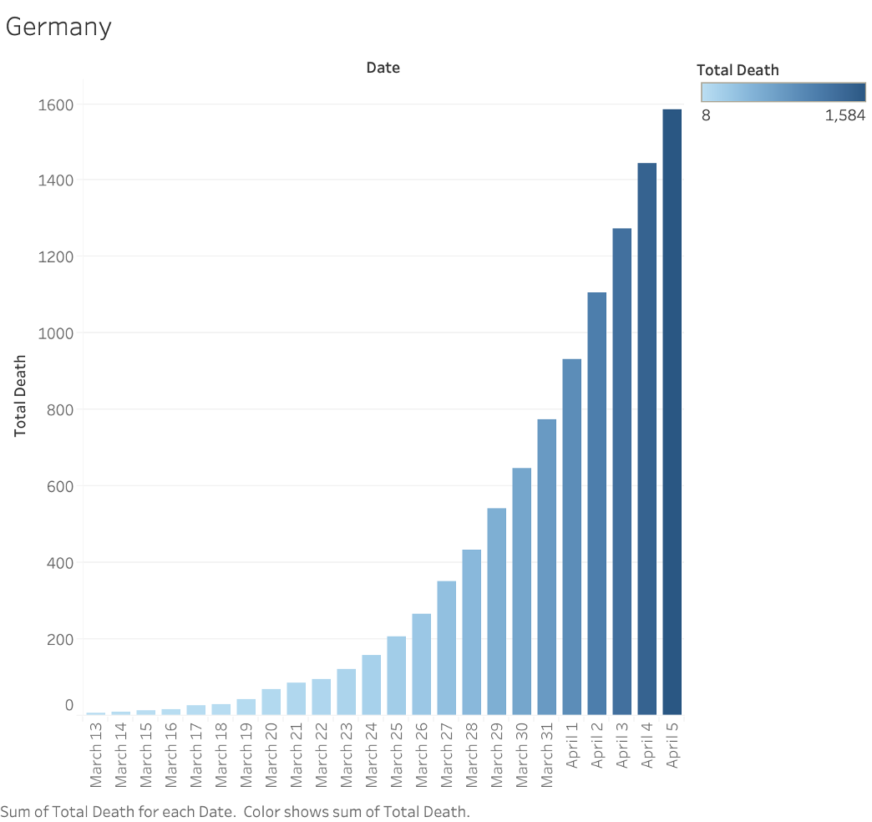
Data for 4/4

Slide 7
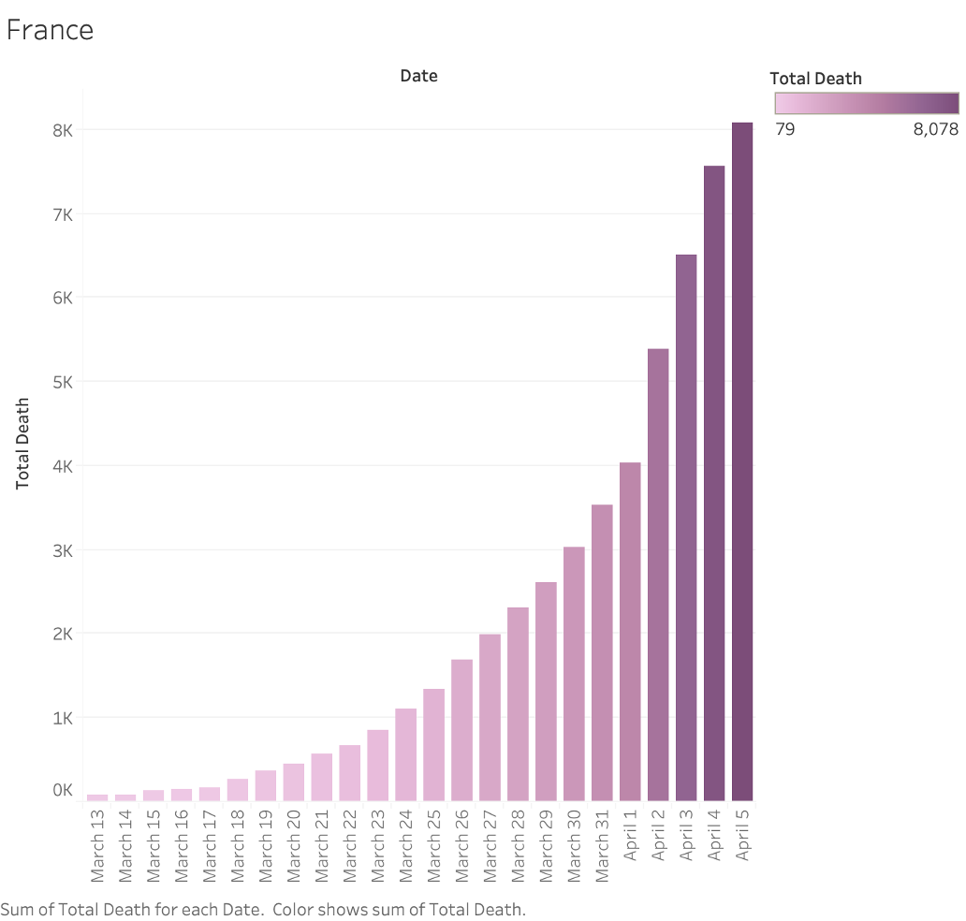
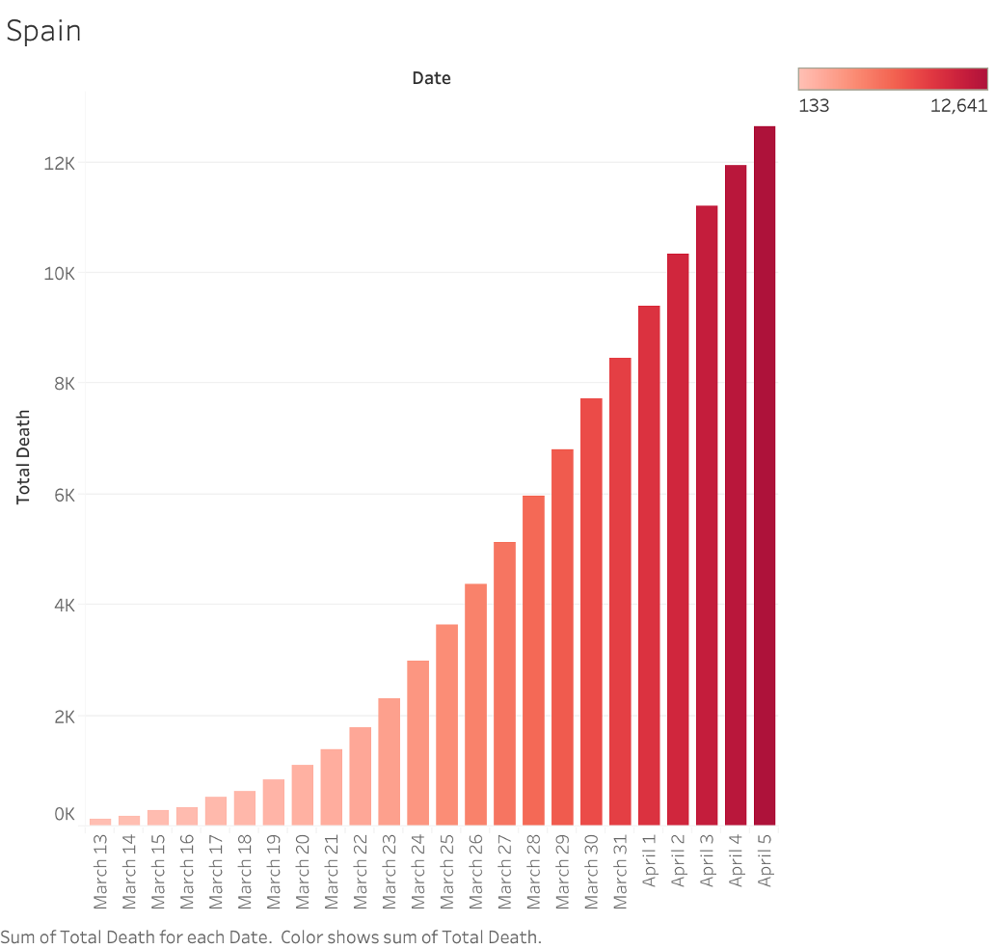

Slide 8
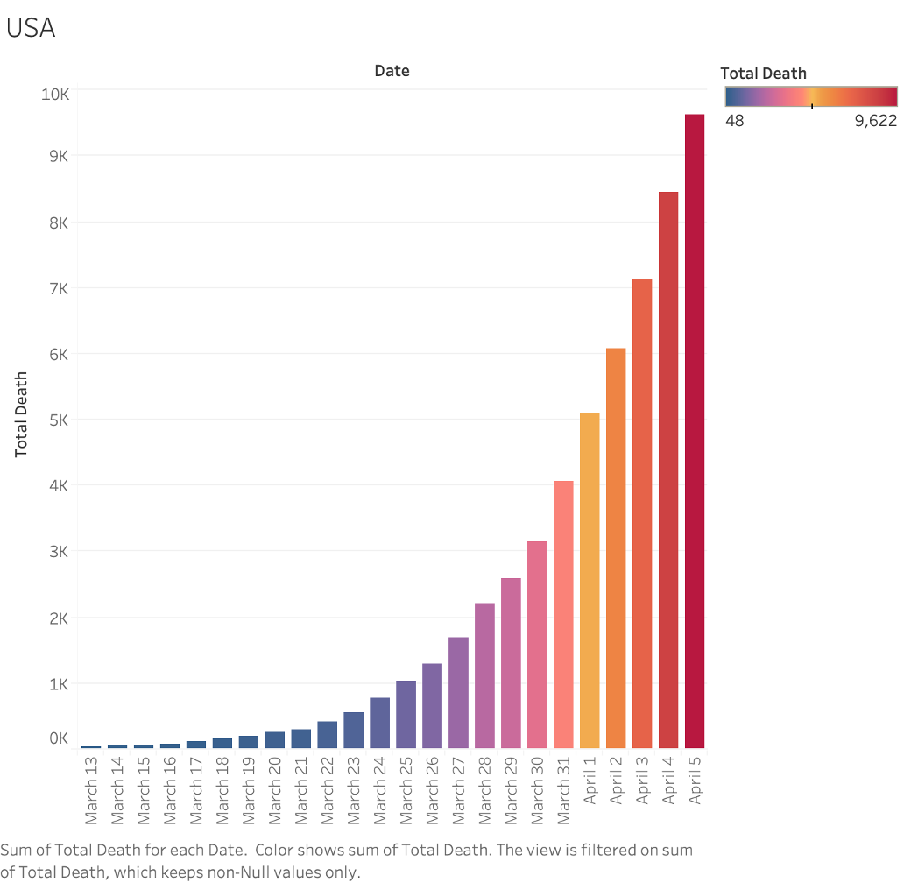
As seen from the given graphs the problem was increasing exponentially.
As this was quite new problem not many sources were available for us to work from.

Slide 9
Previous Works
We referred to the research done on other viral spreads and turns out most techniques used for them is gene sequencing which was not possible for this or a decision tree, linear regression.
Most scientists were of the opinion that when it comes to The prediction of viral-host infectious association by supervised learning model talks about 5 methods including logistic regression, support vector machine, random forest, Gaussian and Naive Bayes
For Zika virus regression and super vector machine was used, for H1N1 gene sequencing and neural network was used although a lot of information was available about these diseases.

Slide 10
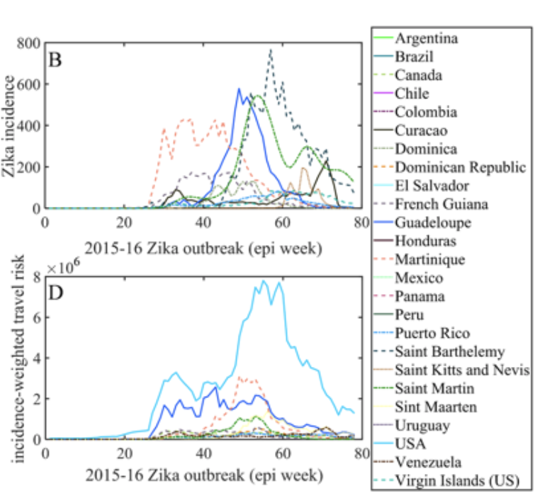
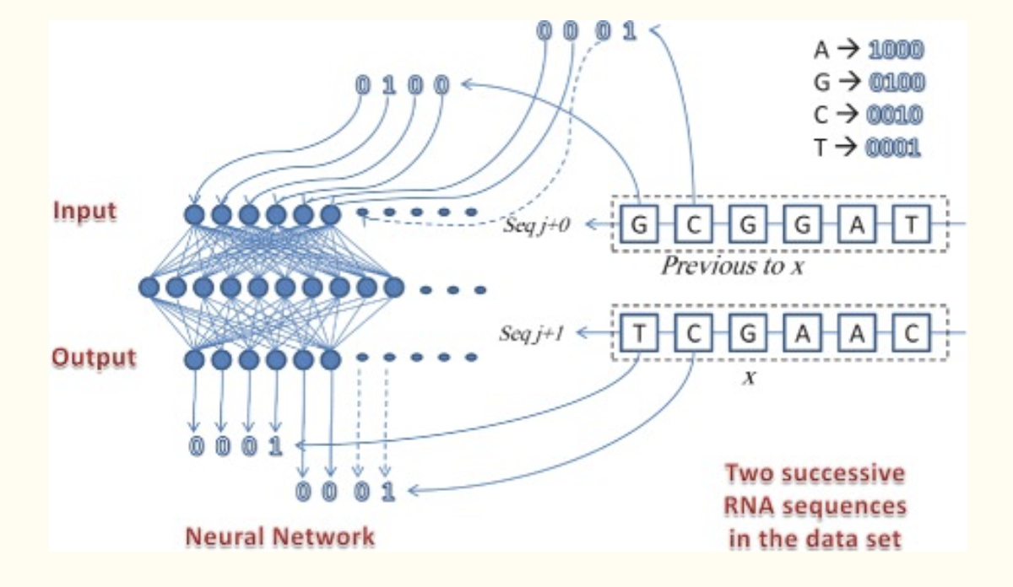
Zika Virus
Taken from BMC medicine Journal
H1N1
Taken from Oxford Academic Journal

Slide 11
What is Linear Regression?
Linear Regression is a predictive analysis tool which describes the relationship of two or more variables using a line.
There are many kinds of linear regressions, including polynomial, simple linear regression and multiple regression.
We will only be covering the first two for the sake of our presentation.

Slide 12
Where else is Linear Regression used?
Linear regression is used in any model that is concerned with seeing how a relationship changes over time.
For us, we thought that we wanted to look at this simple problem and add complexity to it by adding different countries to the mix.
The data was perfect for this comparison, we wanted to understand how location was affecting deaths over time, and predicting deaths accurately for different locations.
To do this, we used sklearn in python for creating the linear regressions, and matplotlib to display our data.

Slide 13
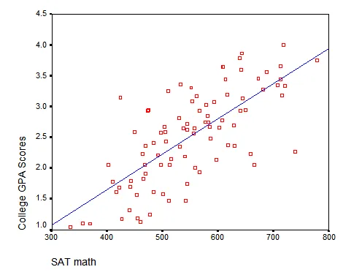
Figure taken from https://www.theanalysisfactor.com/

Slide 14
Methodology
We used linear regression to compare and predict the death rates across countries.
The dates in our dataset were from March 13th to April 5th.
Not only did we want to predict death rates, but we also wanted to draw conclusions from why people were dying based on locations.
The first part of the process involved comparing the countries’ death rates through simple linear regression.

Slide 15
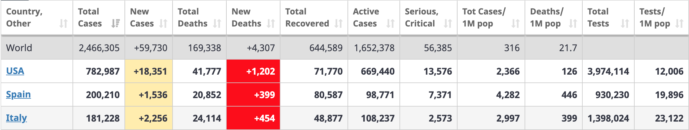
Feature Set
Figure taken from worldometers.info. Data from April 20,2020.

Slide 16
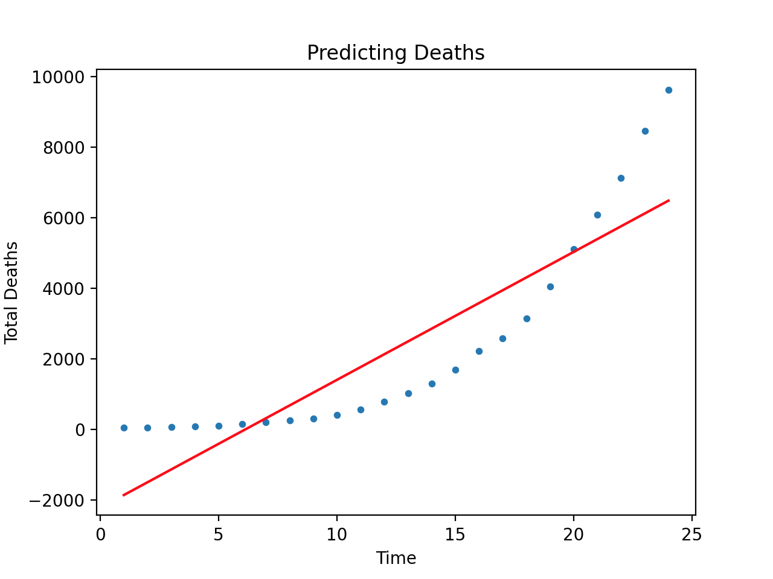
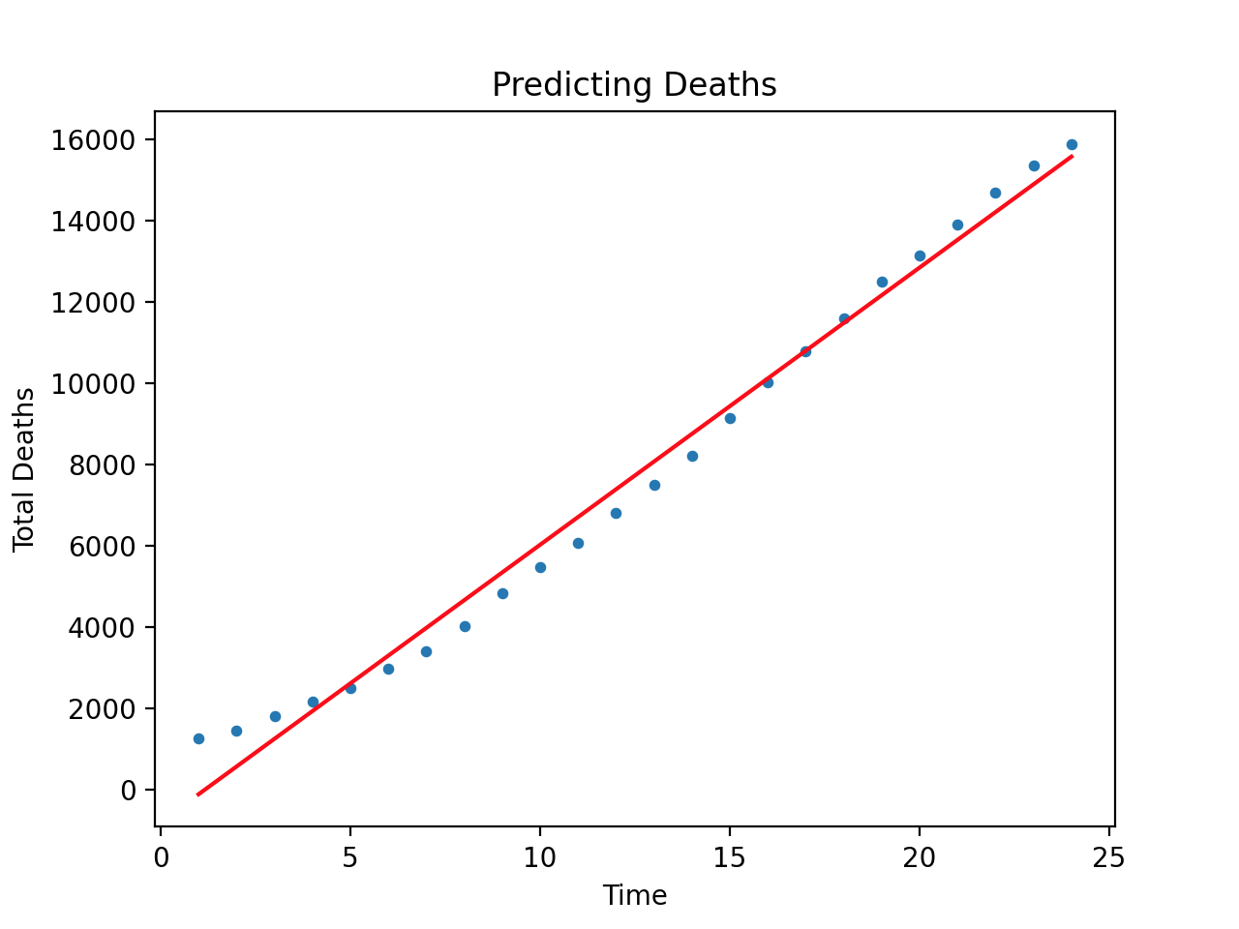
Linear Regression Between Countries
US Linear Regression
Total Deaths over Days
Italy Linear Regression
Total Deaths over Days

Slide 17
Insight
Why does the US graph look so bad?
We are measuring deaths over time, and Italy’s chart had a more linear growth. So it was easier to draw a line.
The US curve had an exponential growth, so it was much harder to draw a line that encapsulated all the points.

Slide 18
R² values: what do they mean?
R² values give us the mean variance of the goodness of fit line in linear regression.
If the value is close to 1, it means that the linear regression fully explains all the variance in the data.
If the value is close to 0, it means that the linear regression doesn’t explain the variance in the data at all.
To compare, Italy’s R² value is 0.98, and the United State’s R² value is 0.77.
One question arises, how do we improve US’ R² value?

Slide 19
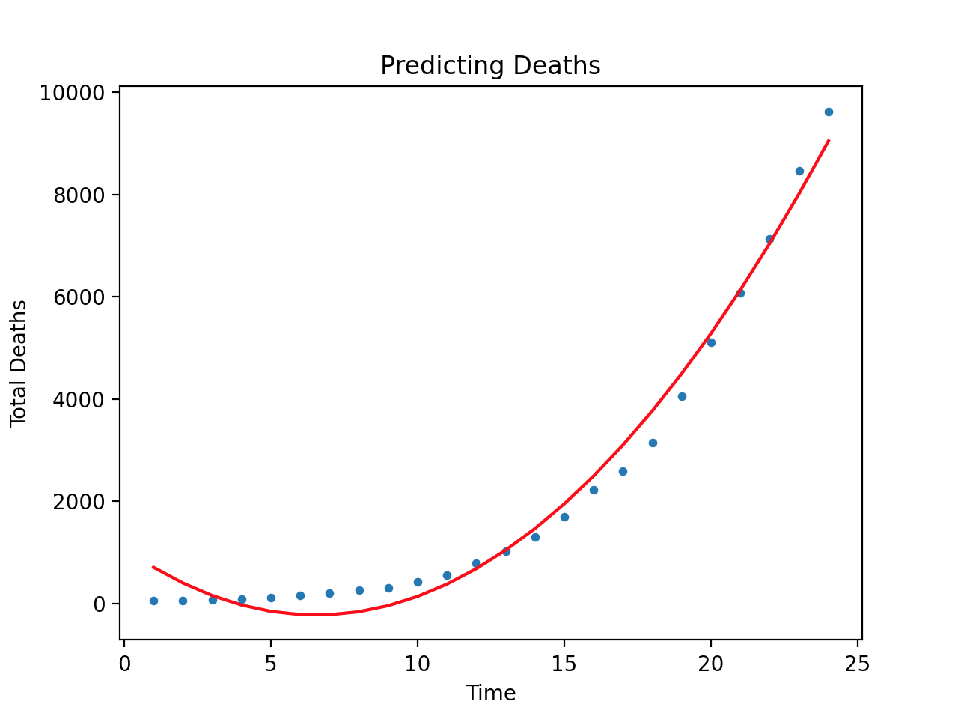
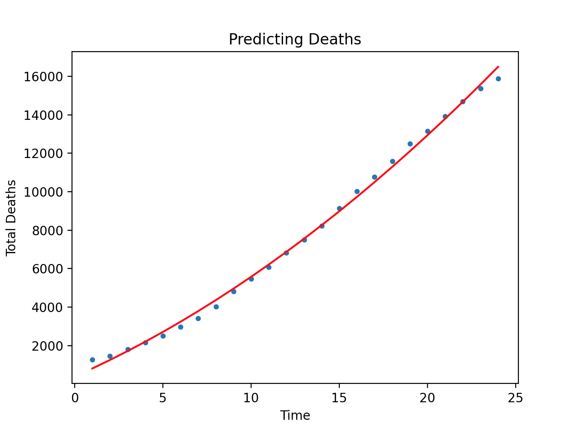
Polynomial Regression Between Countries
US Polynomial Regression
Total Deaths over Days
Italy Polynomial Regression
Total Deaths over Days

Slide 20
Insight
This line actually fits both models better. Italy only by a bit and the US by a lot.
The polynomial R² value for the US is 0.98 and Italy is 0.99 with this model.
The reason why it fits Italy’s data well too is because all lines are instances of curves, but all curves aren’t instances of lines.
It also shows that the US death rate is far more exponential than Italy’s, which is obvious between these two countries, but not so obvious with the other countries we studied.

Slide 21
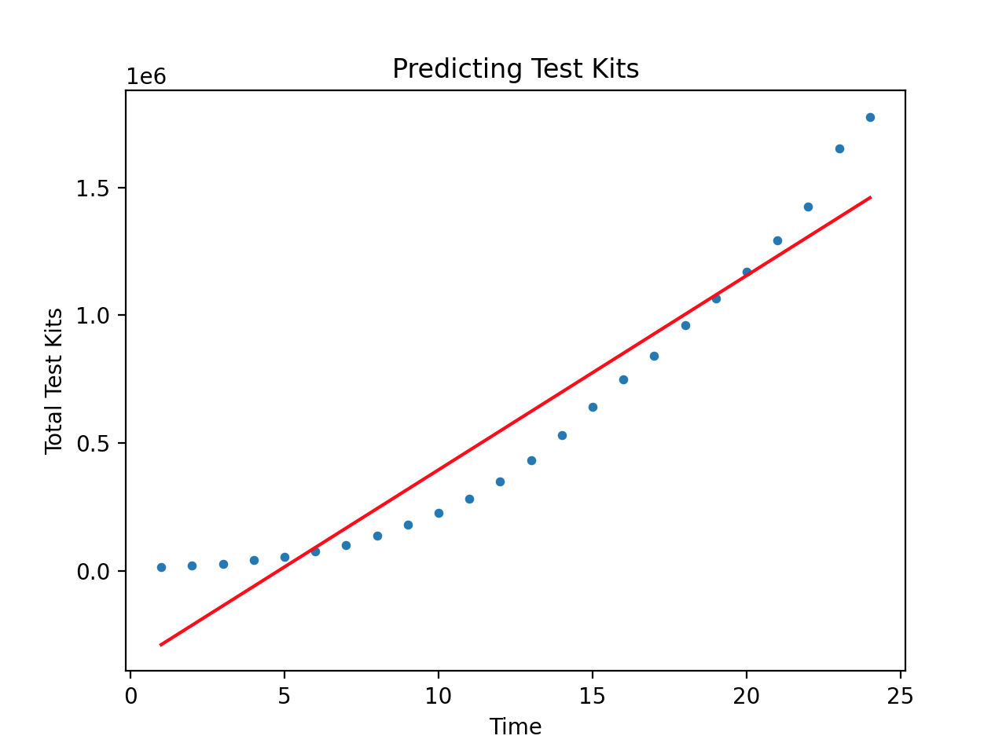
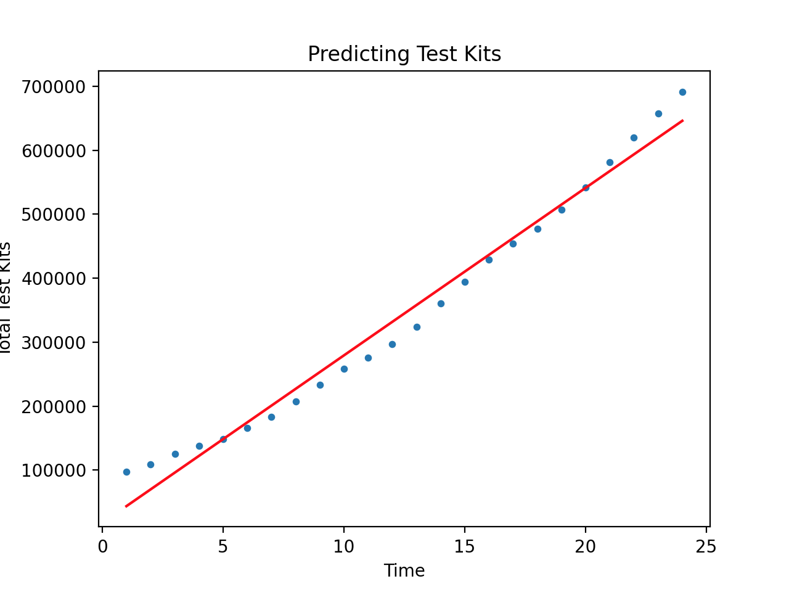
Linear Regression Between Test Kits
US Linear Regression
Total Test Kits over Days
Italy Linear Regression
Total Deaths over Days

Slide 22
Conclusion
The graphs look pretty similar, don’t you think?
One of the interesting correlations we found in this project was that countries tend to have similar death rates and testing kit graphs.
We wish to explore this idea more with future work.
Since we were able to get decent predictions using simple deaths over time, we would want to look at multiple regressions and see how that affects coronavirus death rates.

Slide 23
Future Work
Would like to do multiple regression with feature-set shown previously.
Would like to add a data category as to when lockdowns were instantiated and lifted, as we believe this could be key to understanding the virus better.

Slide 24

Thank you!
Taken from https://en.wikipedia.org/wiki/Mickey_Mouse

